Slide 1
Cultural Awareness and Empathy Alicia Hudson Garr, The Cleveland Museum of Art and Martin Kohn, The Cleveland Clinic Wednesday 6-8-2016
Notes:
Blank with Logo Only

Slide 2
*Audience; has included 1st yr Medical Residents in Internal Medicine from UH; OT/ PT students from CSU; and seasoned medical practioners from the VA Cleveland *Numbers of Students- up to 30 in a session; session length; 20 minutes *Students and seasoned medical practioners were required to be present for the sessions *Their particular program goals were unclear; we communicated that our goals were not to try to suddenly make everyone culturally sensitive but to use the collection as a way to highlight what perceptions they bring to human transactions
Notes:
Text Only, No Images

Slide 3
Our cultural empathy session is on “Beauty” We use objects from non-western galleries to draw an awareness to how culturally-sensitized our ideas of Beauty are.

Slide 4
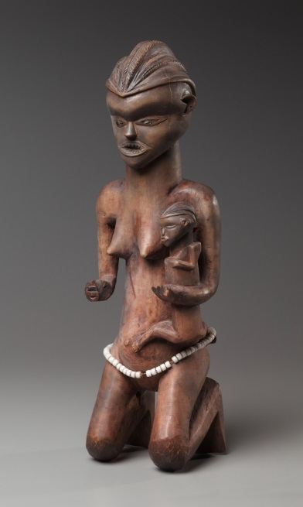
Mother and Child Figure, late 1800s early 1900s, Pende, 1931.426

Slide 5
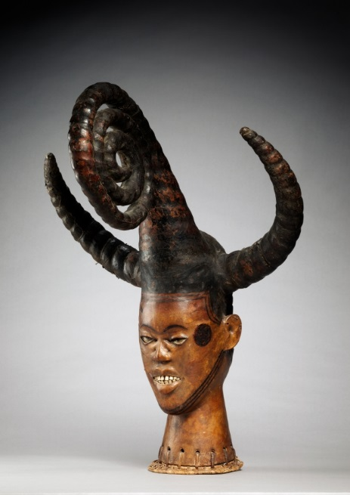
Headdress, early 1900s, Ejagham people, 1990.23
Notes:
Comparative Photos with Text and Captions

Slide 6
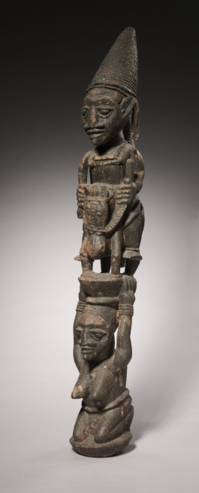
Veranda Post, by Agbonbiofe, early to mid 1900s; 1969.55
Notes:
Horizontal Image with Text and Caption to Photo

Slide 7
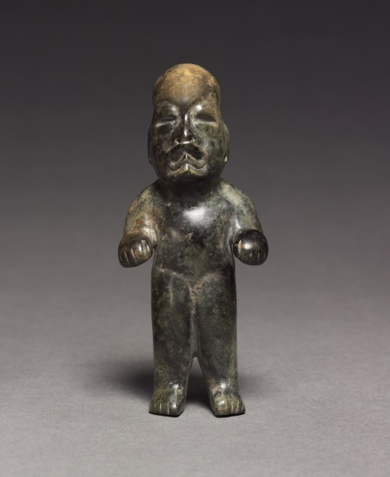
Standing Figure; 900-400 BC; Olmec, 1990.219

Slide 8
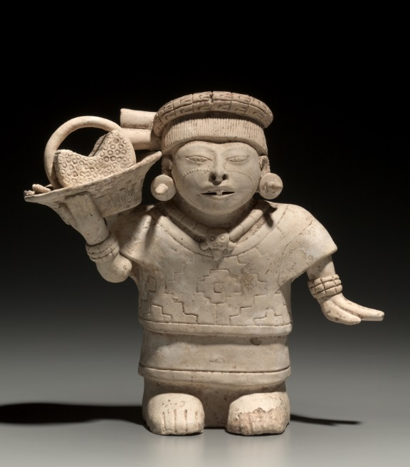
Standing Female with a Basket, 600-1000 AD; Veracruz style

Slide 9
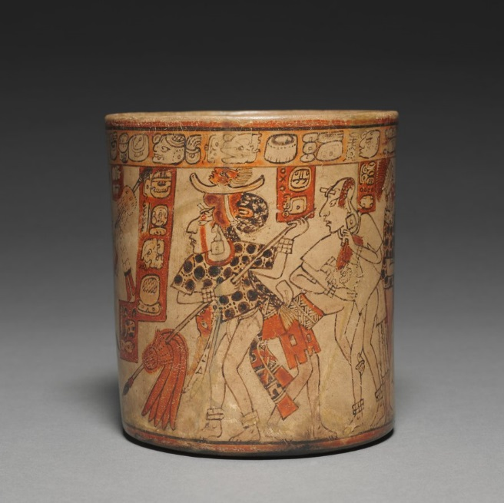
Vessel with Battle Scene, 600-900 AD; Maya culture, 2012.32

Slide 10
We feel this is a useful exercise but never try to imply that we are somehow going to make participants sensitive to other cultures through a one-off experience. But we feel if we are able to give the participants a greater sense of what they bring to human transactions that we are successful.

Slide 12
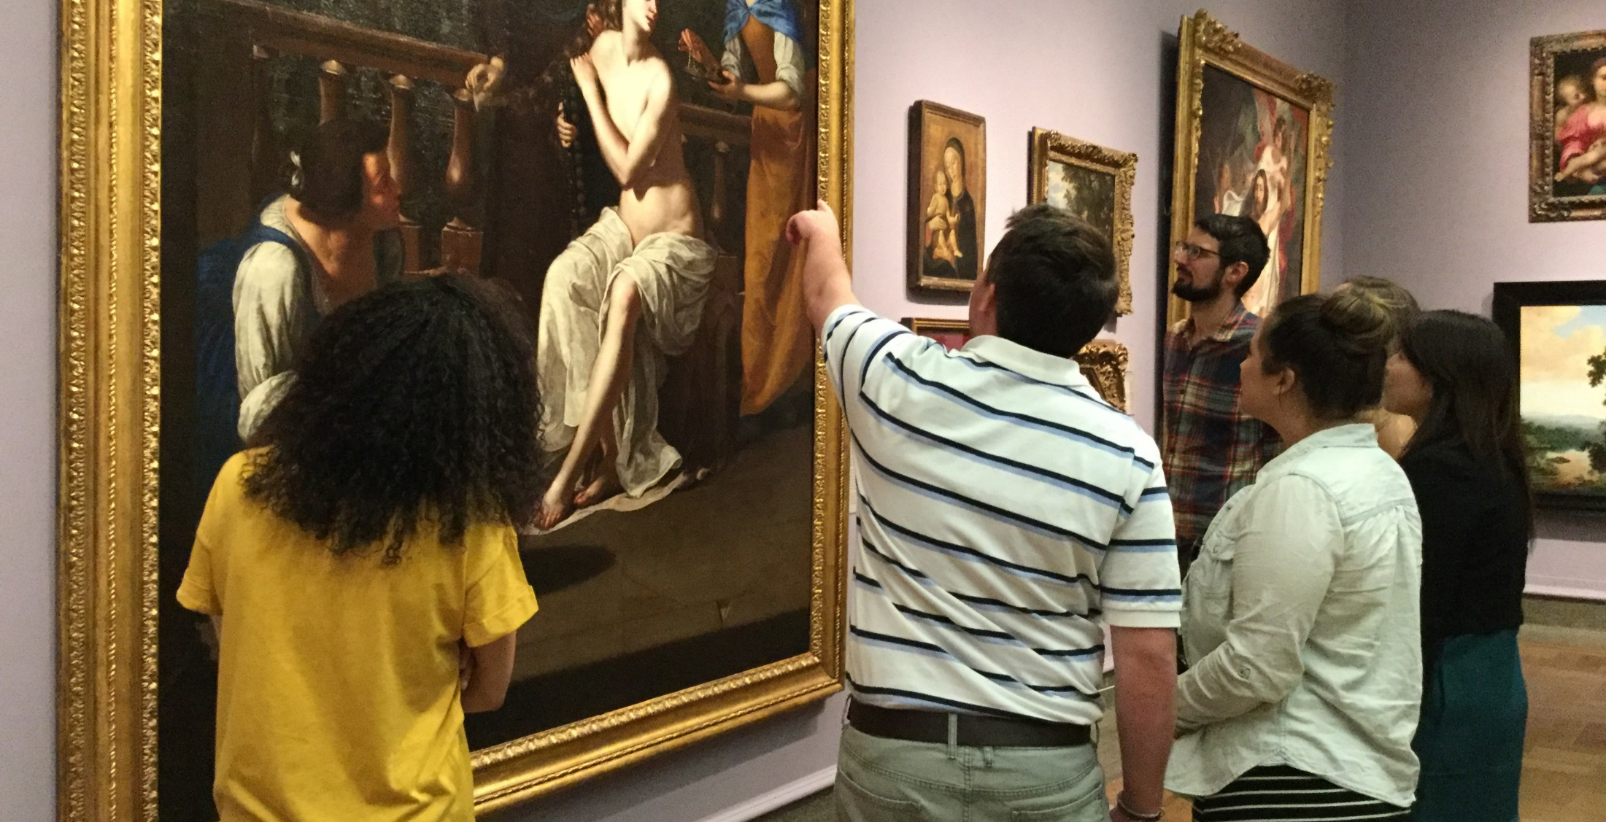
Art of Analysis Jennifer Lehe, Columbus Museum of Art Linda Stone, MD, The Ohio State University College of Medicine
CMA Learning Department Instructors:
Cindy Foley, Executive Deputy Director, Learning & Experience
Jen Lehe, Manager of Strategic Partnerships
Rachel Trinkley, Educator for Docent Programs (formerly)
Stephanie Samera, Docent Programs Coordinator (formerly)
Key OSU College of Medicine faculty:
Dr. Sorabh Khandelwal, Assistant Dean for Clinical Sciences
Dr. Linda Stone, Special Assistant to the Dean
Dr. William Andy Hudson, Associate Director of Medical Education
Dr. Andrew Jacques, Clinical Professor

Slide 13
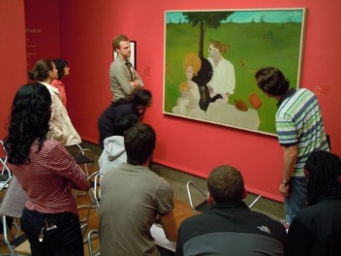
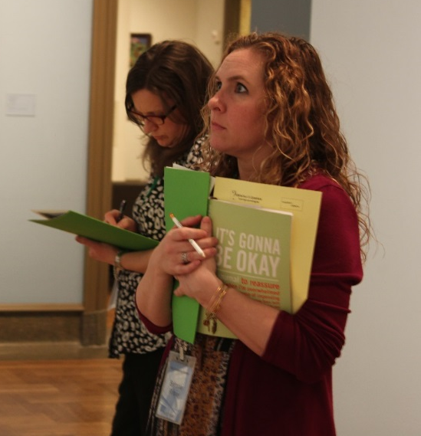
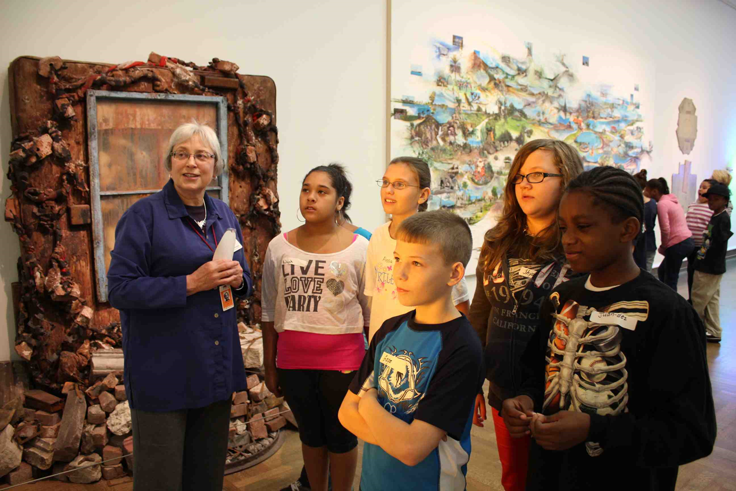
Who: Open to all second year OSU medical students. ~70-80 (of the 195) attend each year, in groups of 12, with a clinical faculty mentor
What: One-time, evening visit (3 hours) beginning with a shared meal and discussion of group and informal learning, CMA staff facilitated thinking routine (ODIP) in galleries, individual prompts, group reflection
Observe Describe Interpret Prove
Careful noticing, resisting initial interpretations, questioning assumptions, adopting different perspectives, imagining, embracing ambiguity, listening to group members, synthesizing elements
Notes:
Jen:
Overview structure of the evening’s key components.
Then describe ODIP and explain 40 min with single work is typical.
What it promotes: Really impt to resist assumptions, to only observe, to build on each other’s ideas, and reason with evidence. To tell stories and wonder naturally arises. Promote careful noticing, resisting assumptions, adopting different perspectives, embracing ambiguity, collaborative thinking—critical and creative thinking skills that are key aspects of empathy
Valuing and studying this kind of thinking led us in 2010 to open the CfC, and most recently to create this strategic roadmap

Slide 14
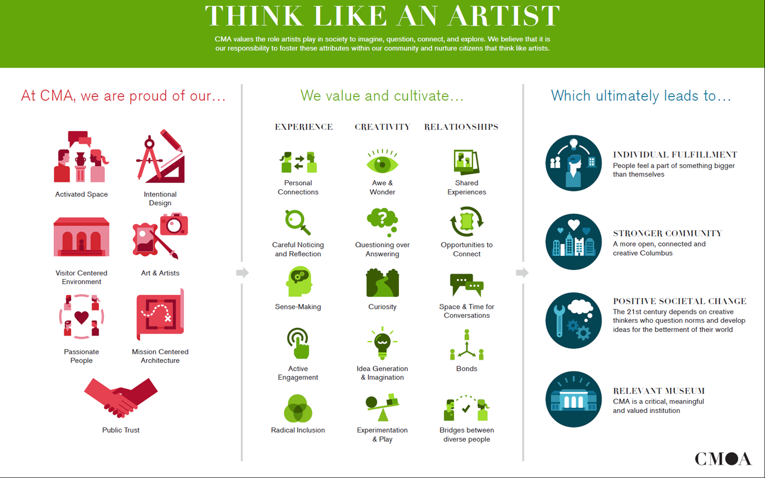
Notes:
Jen: Make this available to you. Designed to guide all of our efforts across the CMA in alignment with what we value about how artists think. Since we are talking about empathy, I want to highlight **********
As educators we know we can only cultivate these behaviors and values if we set the right conditions. AoA is successful because of some key supportive conditions at each of our institutions. Teachers and physicians know this – you can’t compel a behavior, but you can support the conditions for it to develop and thrive. So I want to give a context for what supports AoA from each institution.

Slide 15
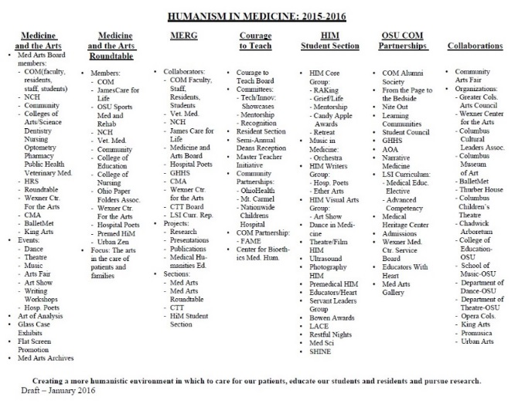
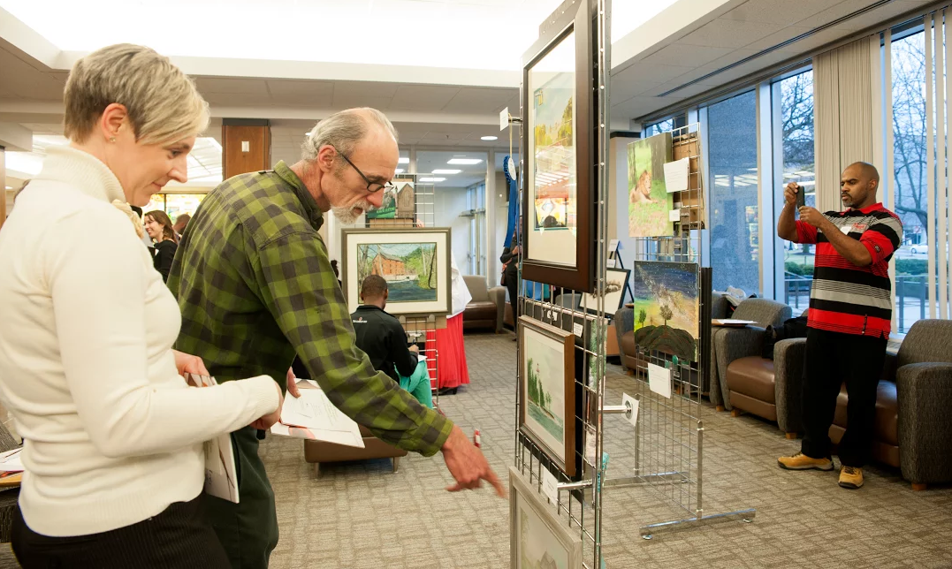
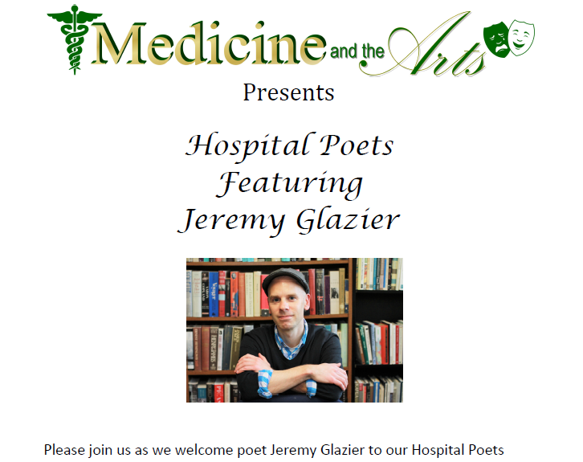
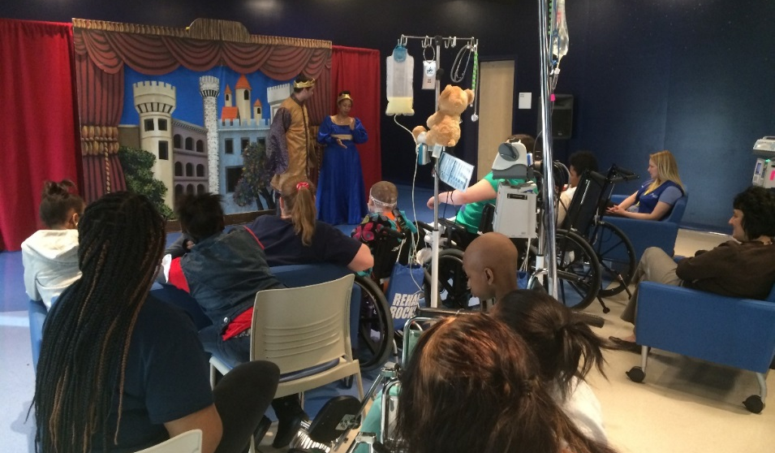
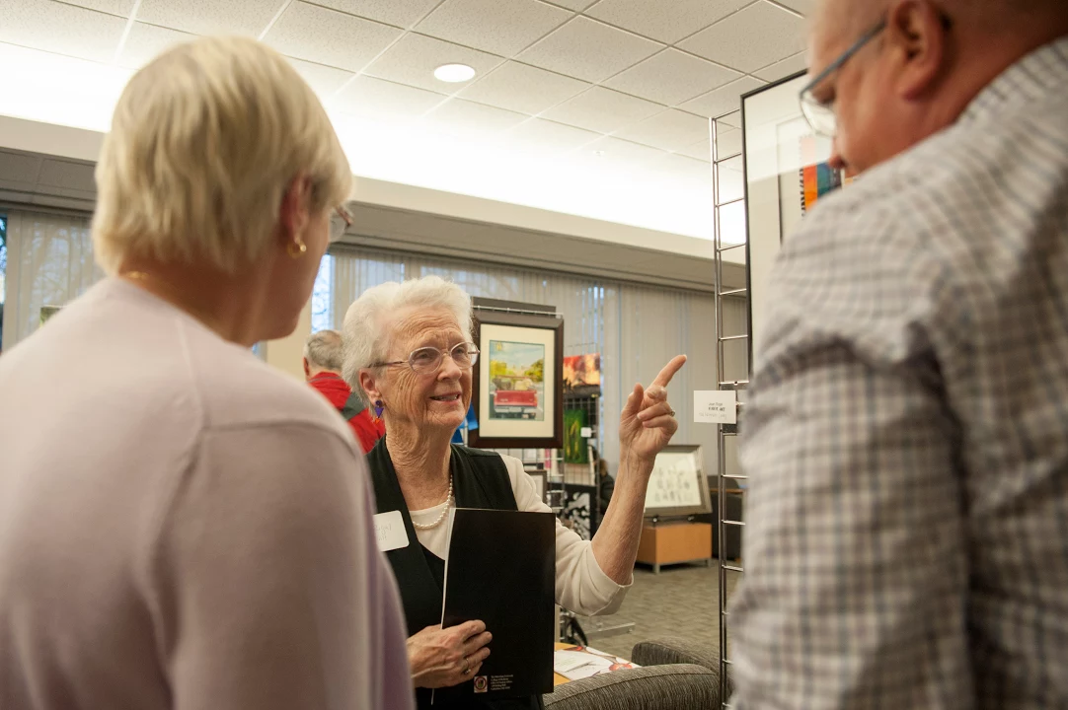
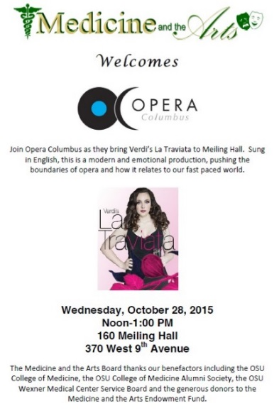
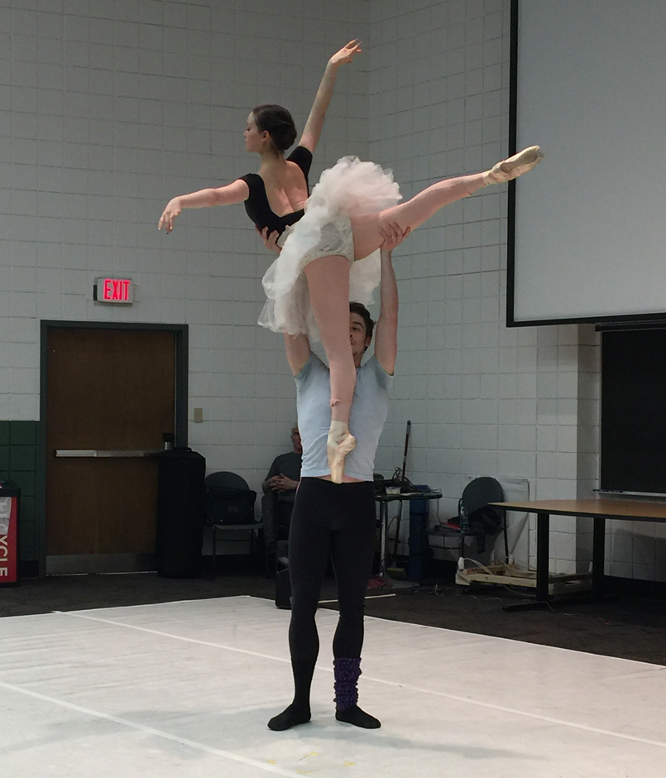
Some key OSU COM conditions for fostering empathetic thinking dispositions:
Emphasis on humanism in medical training and practice
Growing arts partnerships and programs
Recognition of the importance of the arts in patient healing, student training, and physician resiliency
Notes:
Linda: This is designed to give a flavor of how OSU partners with arts orgs, and how these partnerships fit into a larger idea of promoting humanism in medicine. AoA launched a broader set of partnerships, etc. HiM mission “Creating a more humanistic environment in which to care for our patients, educate our students and residents and pursue research”. We see the importance of modeling these values directly with AoA. When faculty are really engaged and visibly supporting of the work, that is felt by the students and the thinking and discussions are richer as a result. Make the space safe for vulnerability and intellectual and creative risk taking.

Slide 16
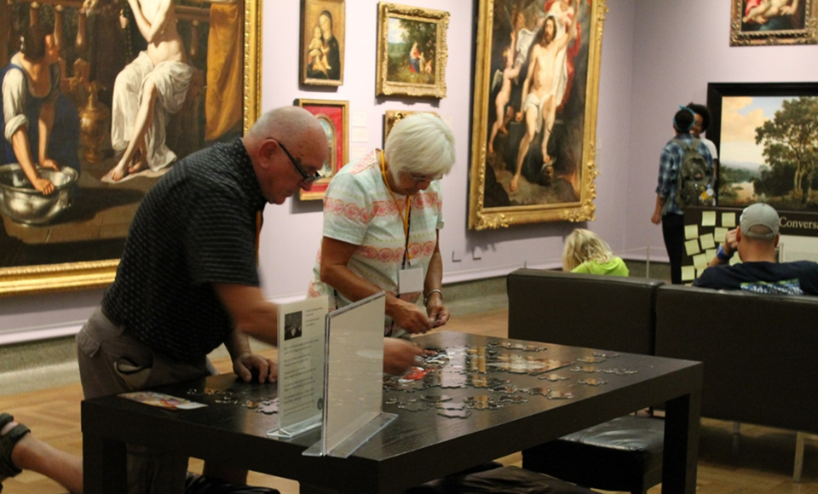
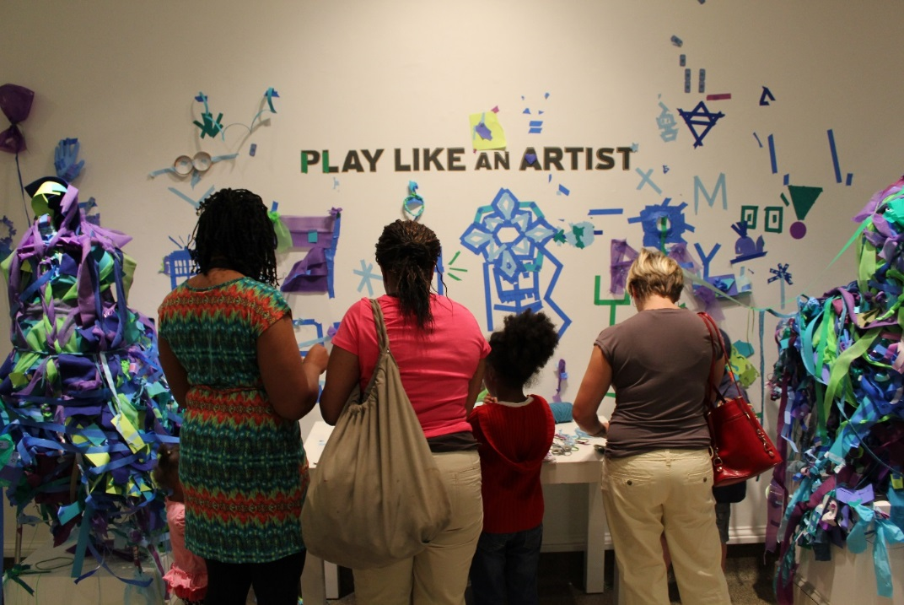
Some key CMA conditions for fostering empathetic thinking dispositions: Learner-centered instruction in a visitor-centered museum Works that support perspective taking and the exploration of social issues Philosophy of active engagement in “thinking like an artist” dispositions of creative and critical thinking
Notes:
Jen: Work in which artists are highlighting or raising questions about social issues provides a perfect opportunity to foster empathy and the behaviors and attitudes that comprise empathy. Intro Jane Reed and Dora Hunt.
Reiterate structure of AoA – highlight the kind of thinking that students engage in

Slide 17
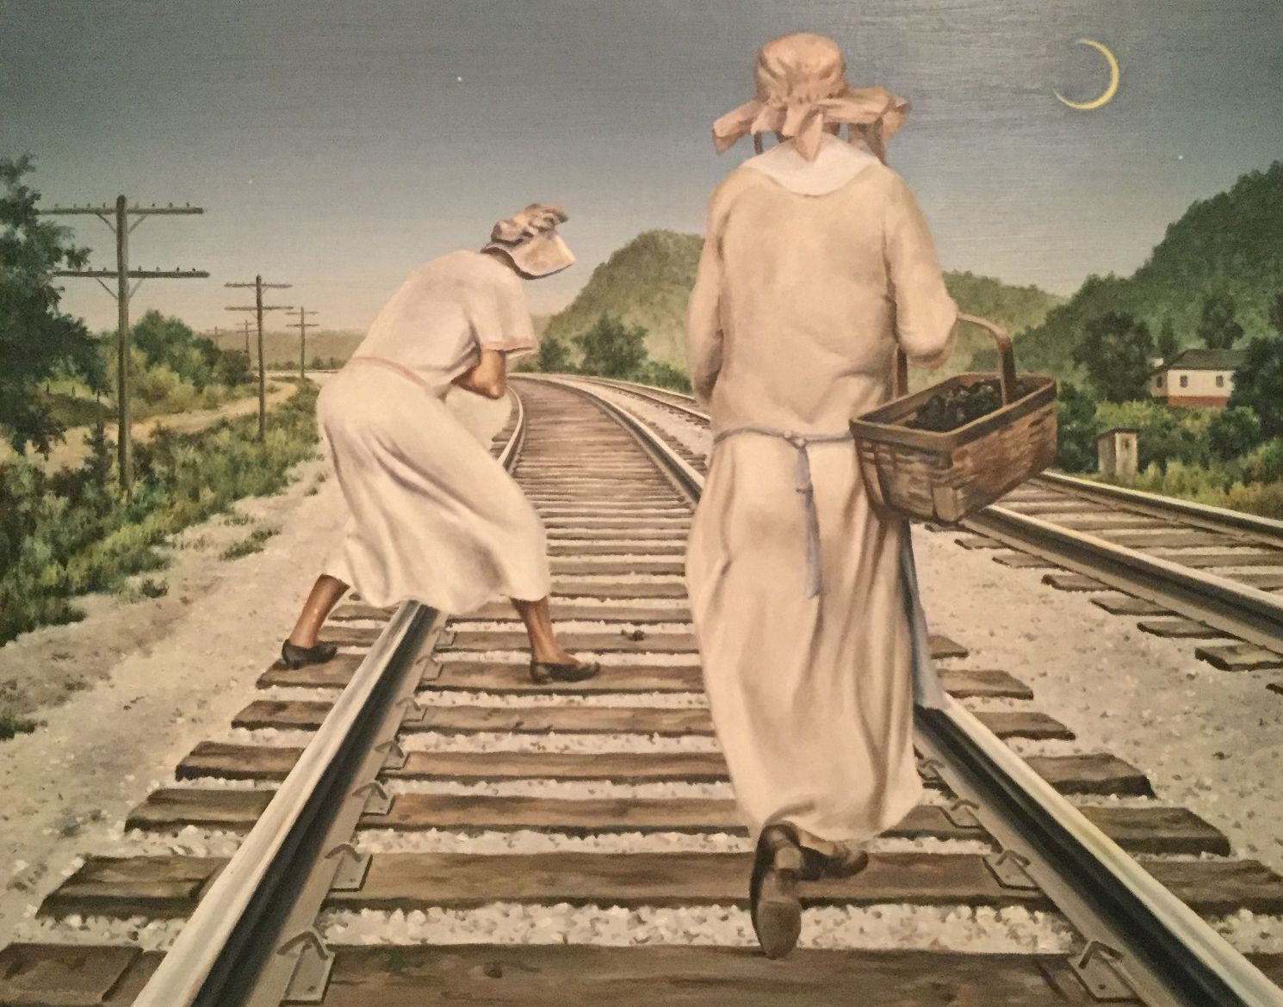
Jane Reed and Dora Hunt, Clarence Carter, 1941
Notes:
So, what does TLA look like in AoA. Both group ODIPing and individual works are designed to open us to multiple perspectives and questioning our assumptions. We often use this work, Jane Reed and Dora Hunt by Clarence Carter during the group ODIP portion, in part because we know almost nothing about it, and there is no additional label copy beyond the basics.– a few points often raises: their names but no faces, the powerlines with no wires yet, how we know what we know (e.g. southern Ohio v. city), imagine narratives for them.
On the left you see a form which actually comes from the second activity, in which we give the students a form and send them to find a work that represents an idea (such as care, compassion, good teaching, etc), or in this case, a work that does not immediately appeal to you. This prompt is interesting because it is linked more directly with some behaviors of empathy – going through a process that you ordinarily would not…It requires that you resist first impressions, carefully observe, then interpret and reason with evidence. This is a prompt I like to use with visitors of all ages, and often they respond that in the end they have actually come to like the work. It actually isn’t important to me that they “like” the work afterward, but that they understand what can be learned by taking the time, setting aside that gut reaction and really exploring something. This feels powerfully linked to the idea of empathy – setting yourself aside for a time and exploring another. You’ll also notice that she’s unearthing some pretty subtle social aspects of the work. My first AoA we looked at this together for 40 minutes and it was incredible the aspects that I had taken for granted, but which were upended by their collaborative noticing – powerlines not yet strung.

Slide 18
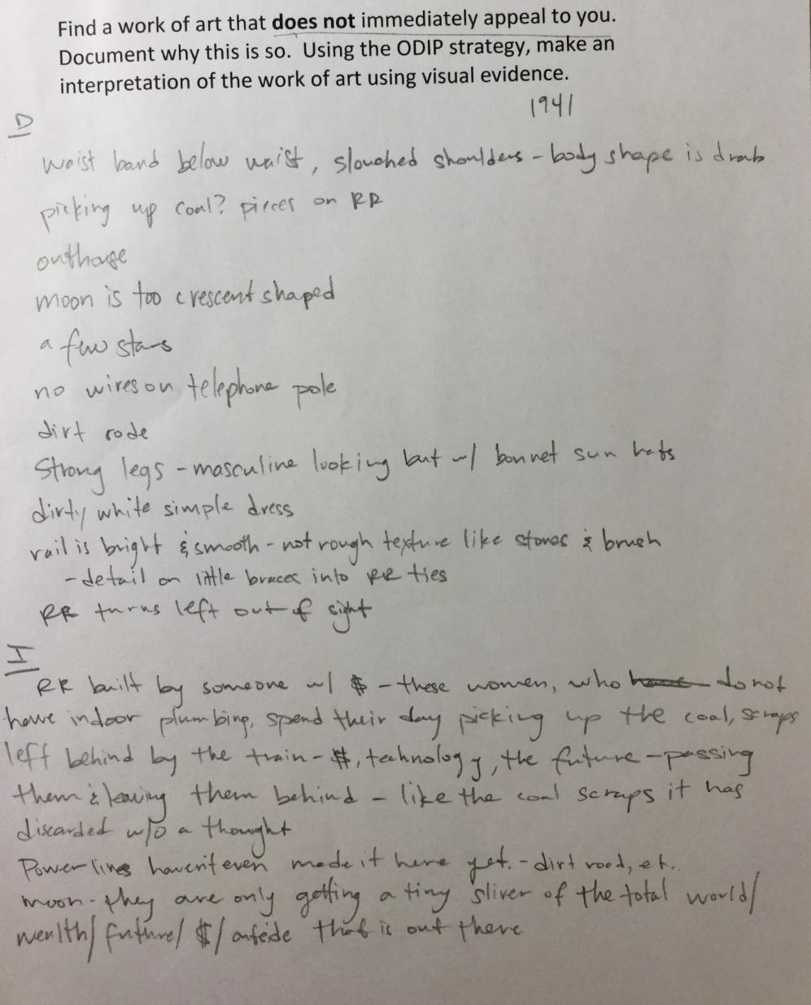
Notes:
So, what does TLA look like in AoA. Both group ODIPing and individual works are designed to open us to multiple perspectives and questioning our assumptions. We often use this work, Jane Reed and Dora Hunt by Clarence Carter during the group ODIP portion, in part because we know almost nothing about it, and there is no additional label copy beyond the basics.– a few points often raises: their names but no faces, the powerlines with no wires yet, how we know what we know (e.g. southern Ohio v. city), imagine narratives for them.
On the left you see a form which actually comes from the second activity, in which we give the students a form and send them to find a work that represents an idea (such as care, compassion, good teaching, etc), or in this case, a work that does not immediately appeal to you. This prompt is interesting because it is linked more directly with some behaviors of empathy – going through a process that you ordinarily would not…It requires that you resist first impressions, carefully observe, then interpret and reason with evidence. This is a prompt I like to use with visitors of all ages, and often they respond that in the end they have actually come to like the work. It actually isn’t important to me that they “like” the work afterward, but that they understand what can be learned by taking the time, setting aside that gut reaction and really exploring something. This feels powerfully linked to the idea of empathy – setting yourself aside for a time and exploring another. You’ll also notice that she’s unearthing some pretty subtle social aspects of the work. My first AoA we looked at this together for 40 minutes and it was incredible the aspects that I had taken for granted, but which were upended by their collaborative noticing – powerlines not yet strung.

Slide 19
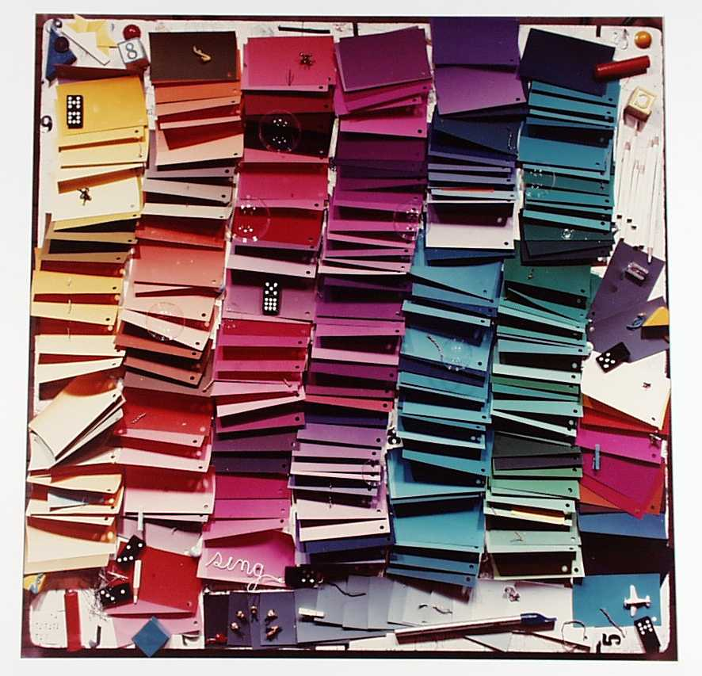
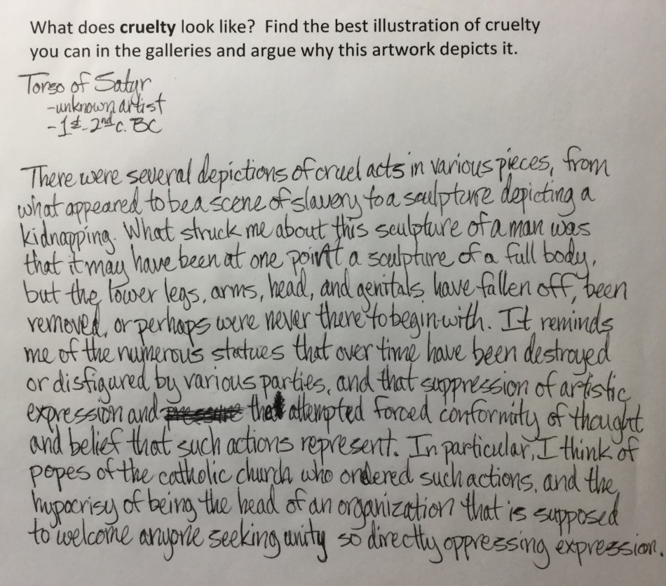
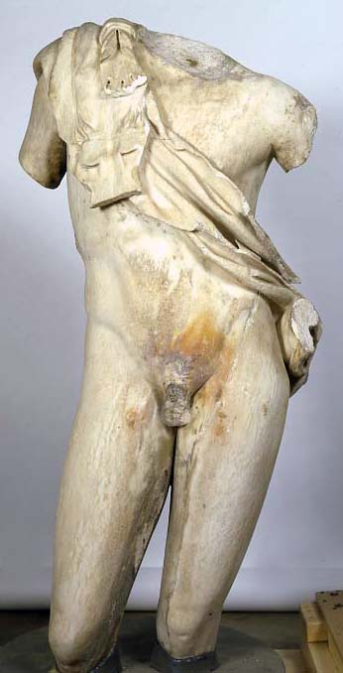
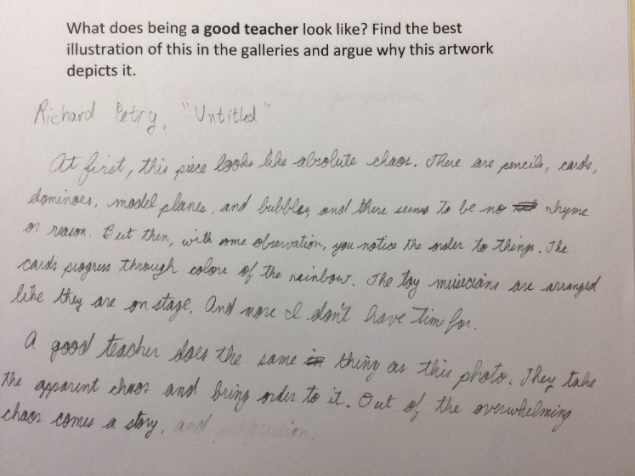
Notes:
Not only explicitly socially charged work that we look at.

Slide 20
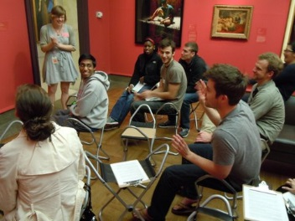
Response Data (2013, 2014, 2015 participants, n=197) % “Agree” or “Strongly Agree”
Looking at and talking about works of art allowed me to reflect on the human experience: 80%
Facilitators helped create a respectful and thoughtful learning environment: 86%
Previous Museum Experiences Many or numerous= 32% Very few or none= 37%
“I will approach patients with an open and curious mind, not brush off something that doesn’t make sense to me, and not anchor to one thing or diagnosis and stop exploring”
“I will try to keep in mind the different life experiences patients have and use that to help me better support them…It was fascinating to hear such different perspectives on the same pieces of art”
[Surprised] “How much I appreciated the opportunity to slow down”
“I was excited to hear what other people had to say, what their interpretations were, and how I responded (often emotionally) to their ideas”
Notes:
As a result of this program, I will change the way I interact with patients/trainees: 53%
Overall, how satisfied were you with this program? 94%
[Another person responded to question 12 – “yes and no, I think the idea of this program is wonderful, and having that 1st experience assessing paintings/art and thinking about them should be done regularly. This was only one of many experiences each person should have” – this points to our “future directions”
But more interesting are the responses and how you can see the behaviors of empathy and connections btw empathy and professional practice

Slide 21
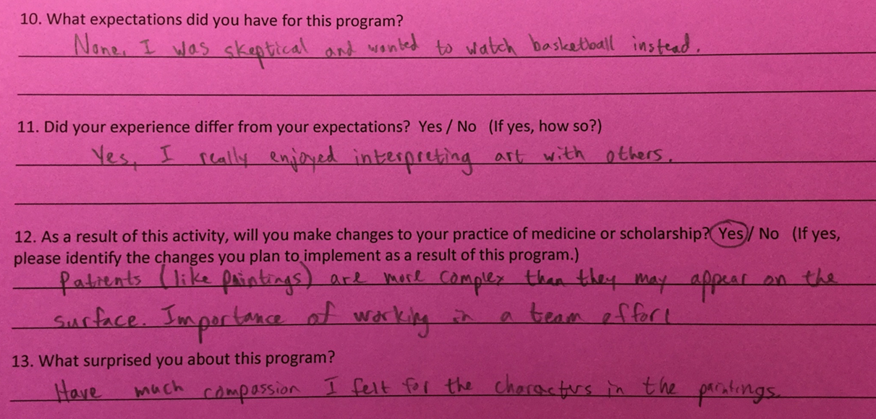
Notes:
Intern – collating more recent data to add; read this response form.
[Another person responded to question 12 – “yes and no, I think the idea of this program is wonderful, and having that 1st experience assessing paintings/art and thinking about them should be done regularly. This was only one of many experiences each person should have” – this points to our “future directions”
Future directions – seeking funding for a more intensive evaluation, TLA, humanism
And because we believe that it is questions, not answers, that drive imagination and innovation, our question looking ahead is How might our collaboration help embed humanistic approaches to patient care, professional training, and practitioner resiliency?

Slide 23
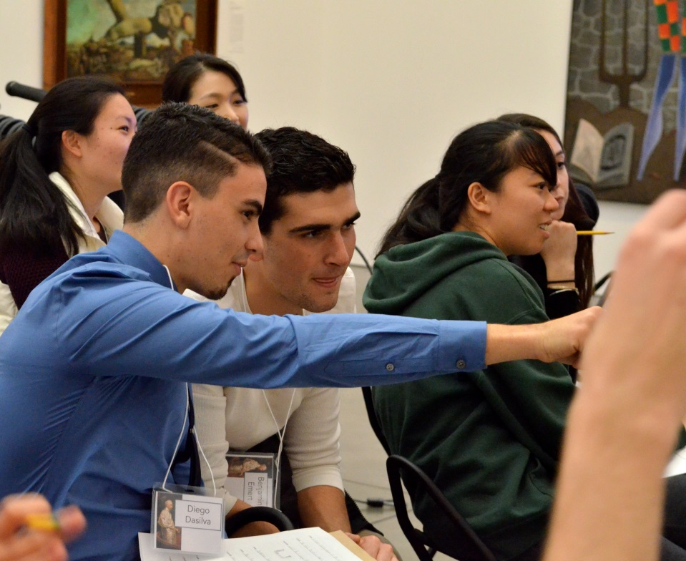
Building Observation and Empathy Through Art
Horace M. DeLisser, M.D.
Associate Dean for Diversity and Inclusion
Perelman School of Medicine, University of Pennsylvania
Suzannah Niepold
Manager of Teacher Services
Philadelphia Museum of Art
Barbara Bassett
The Constance Williams Curator of Education, School & Teacher Programs
Philadelphia Museum of Art
A Partnership of the Perelman School of Medicine and
The Philadelphia Museum of Art
Notes:
CRH vs. Draveil (Neha quote)
Johns (multiple pov, grey area)
Wrath of the Gods
Interior, Sugarcane, Yarrow

Slide 24
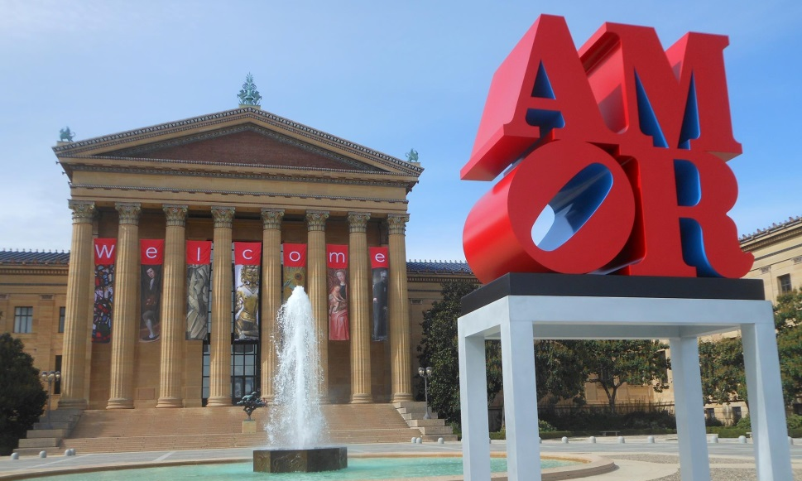
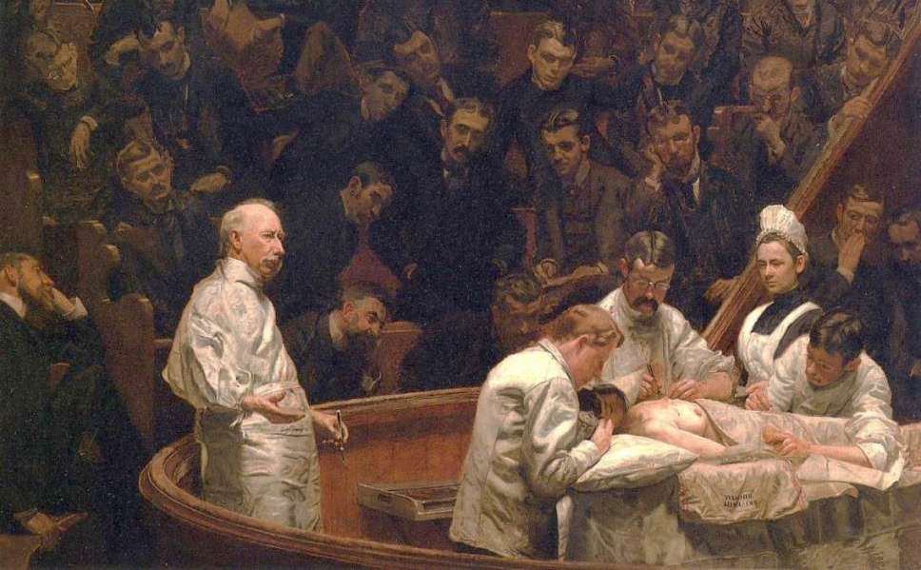
Course Overview
Audience: 15-20 first year students, elective
Course: 7 Sessions
(90-120 minutes)
Goals:
Develop visual art observation skills
Develop clinical observation skills, specifically targeted at retinal and facial conditions
Develop empathy for others
Assessment: double-blind study, pre- and post-tests

Slide 25
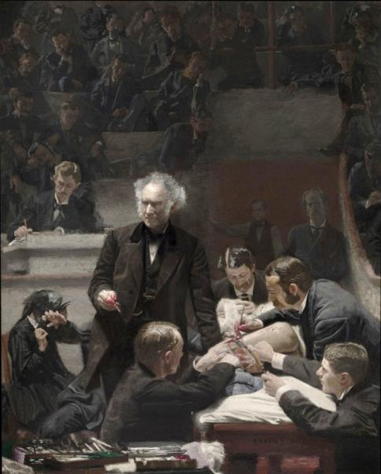
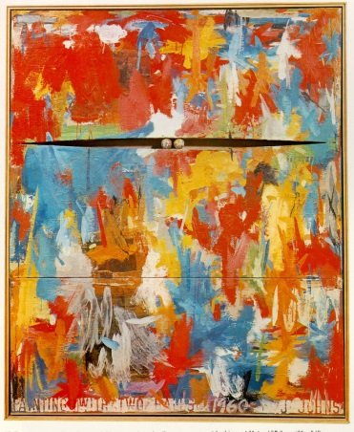
From the familiar to the unknown
Artful Thinking Routines: Color, Shape, Line and Looking 10x2

Slide 26
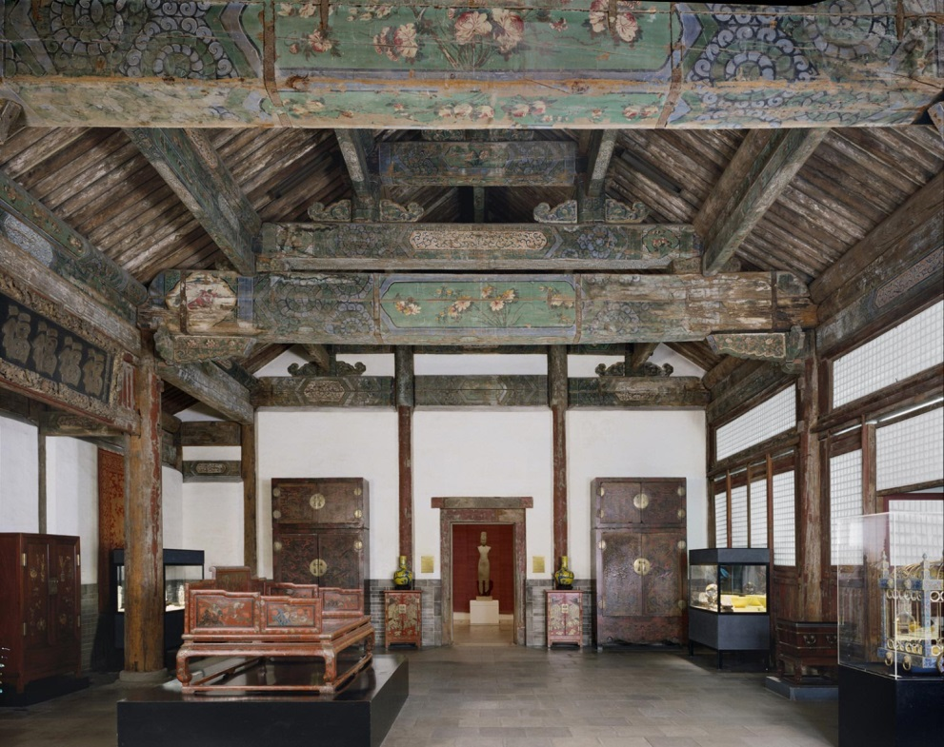
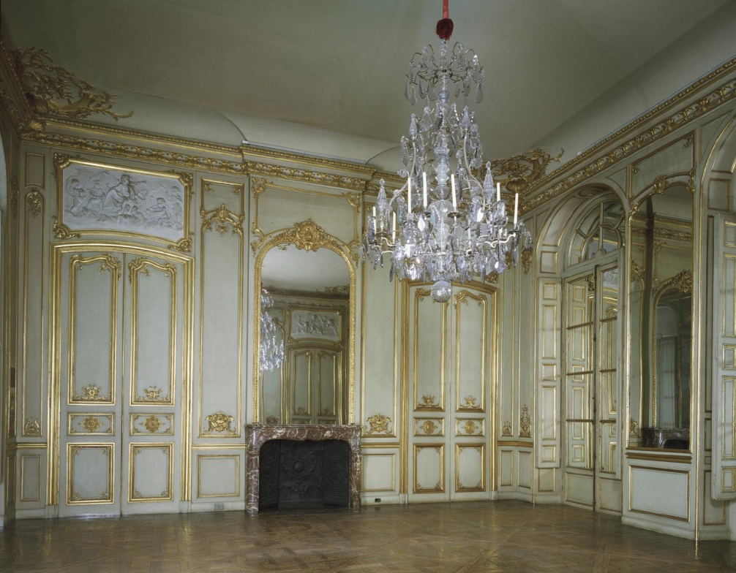
Cultural Awareness
Artful Thinking Routine: Think, Puzzle, Explore
Notes:
Reception Hall from the Palace of Duke Zhao (Zhaogongfu)
Artist/maker unknown, Chinese
Geography: Made in Beijing, China, Asia
Period: Ming Dynasty (1368-1644)
Date: First half of 17th century
Medium: Wood with painted decoration
Dimensions: 18 feet x 46 feet 4 1/4 inches x 35 feet 2 1/2 inches (548.6 x 1412.9 x 1073.2 cm)
Curatorial Department: East Asian Art
* Gallery 226, Asian Art, second floor
Accession Number: 1929-163-1
Credit Line: Gift of Edward B. Robinette, 1929
Grand Salon of the Château de Draveil
Built for Marin de La Haye, French, died 1753
Geography: Made in France, Europe
Date: c. 1735
Medium: Mirrors, carved and gilded oak paneling, and sculpted reliefs
Dimensions: 15 x 24 x 22 feet (457.2 x 731.6 x 670.6 cm)
Curatorial Department: European Decorative Arts and Sculpture
* Gallery 260, European Art 1500-1850, second floor
Accession Number: 1928-58-1
Credit Line: Purchased with Museum funds, 1928

Slide 27
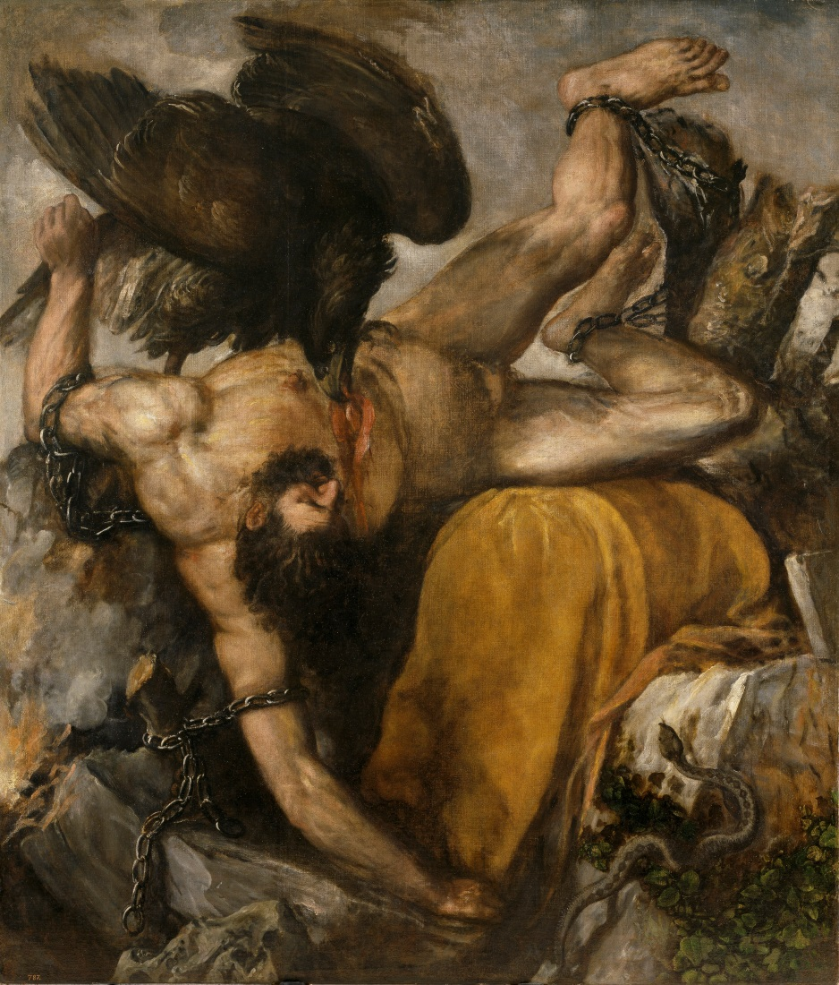
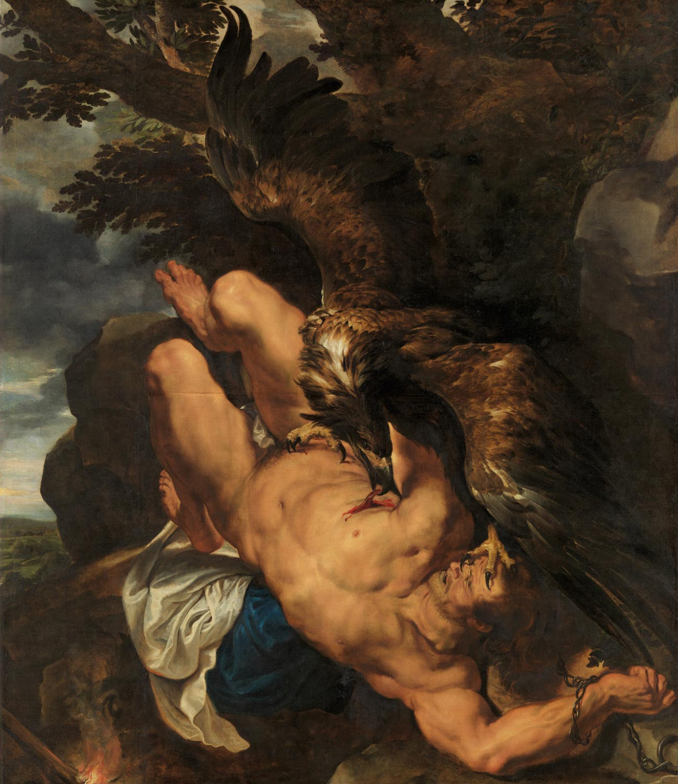
Who is suffering the most?
Artful Thinking Routine: Claim, Support, Question
Notes:
Tityus
1548-49 Oil on canvas, 253 x 217 cm Museo del Prado, Madrid
Prometheus Bound
The eagle was painted by Snyders
Peter Paul Rubens, Flemish (active Italy, Antwerp, and England), 1577 - 1640, and Frans Snyders, Flemish (active Antwerp), 1579 - 1657.
Geography: Made in Southern Netherlands (modern Belgium), Europe
Date: Begun c. 1611-1612, completed by 1618
Medium: Oil on canvas
Dimensions: 7 feet 11 1/2 inches × 6 feet 10 1/2 inches (242.6 × 209.6 cm)
Curatorial Department: European Painting
* Gallery 258, European Art 1500-1850, second floor
Accession Number: W1950-3-1
Credit Line: Purchased with the W. P. Wilstach Fund, 1950

Slide 28
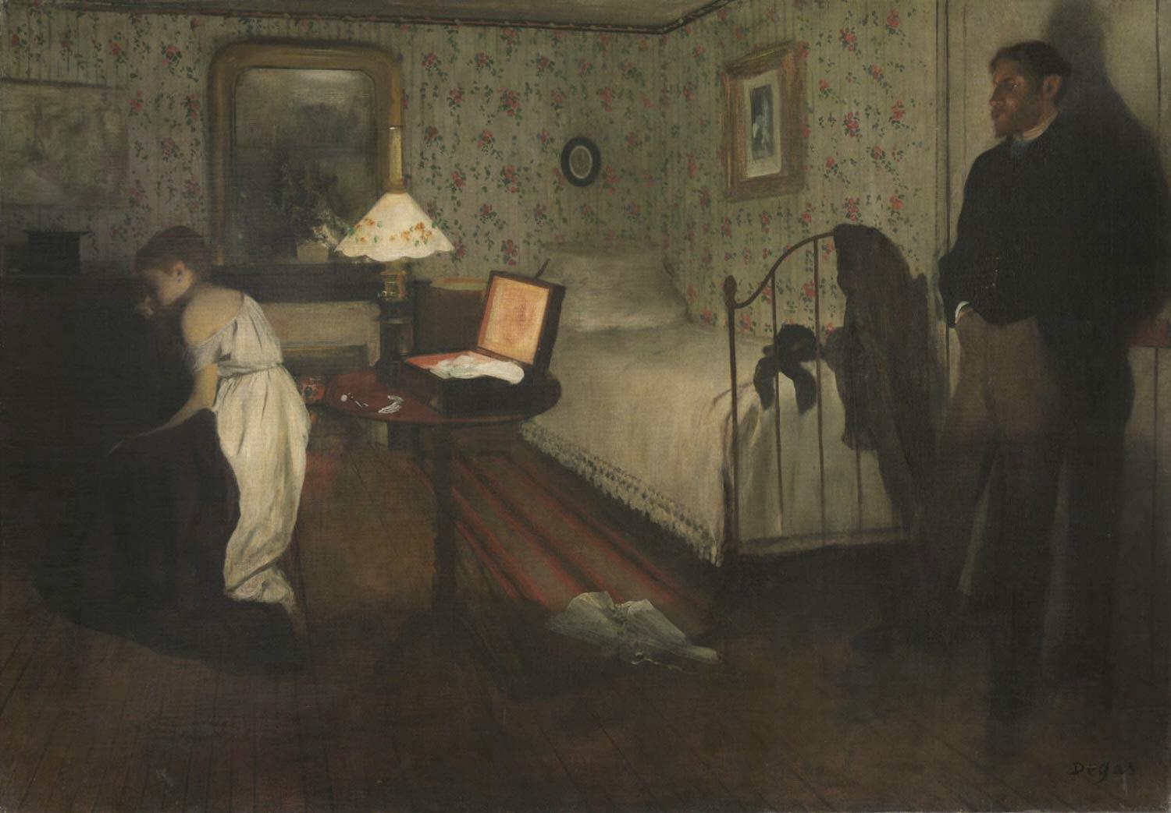
Seeing from multiple perspectives
Artful Thinking Routine: Step Inside
Notes:
Interior: reading a situation, seeing from another point of view, multiple perspectives (critics, sources), grey area, NO RIGHT ANSWER
Interior
Hilaire-Germain-Edgar Degas, French, 1834 - 1917
Geography: Made in France, Europe
Date: 1868 or 1869
Medium: Oil on canvas
Dimensions: 32 x 45 inches (81.3 x 114.3 cm) Framed: 45 × 58 1/2 × 4 1/4 inches (114.3 × 148.6 × 10.8 cm)
Curatorial Department: European Painting
Object Location:Currently not on view
Accession Number: 1986-26-10
Credit Line: The Henry P. McIlhenny Collection in memory of Frances P. McIlhenny, 1986

Slide 29
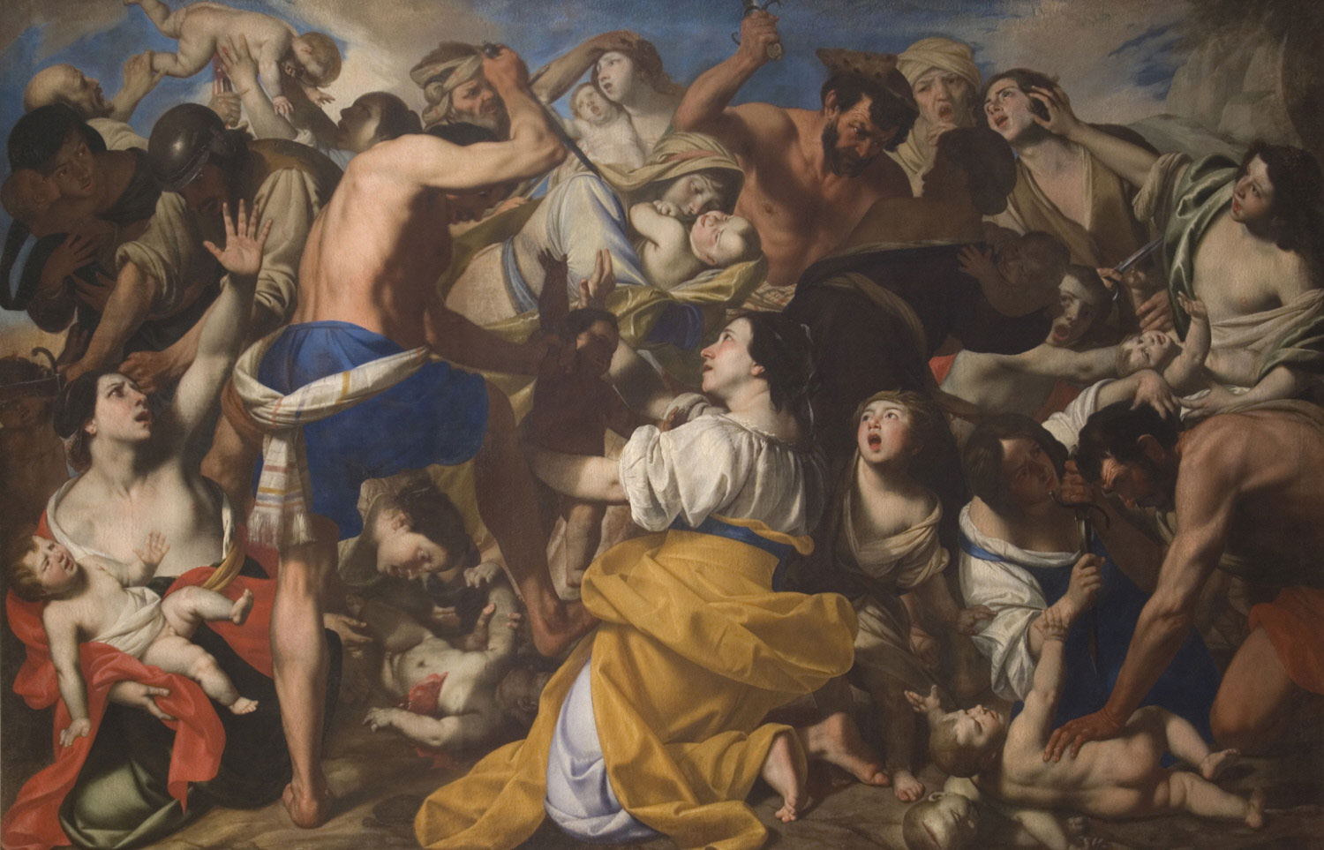
Prompt: Find an image of a person with whom you find it difficult to empathize
Personal Response Tour
Notes:
Massacre: personal response prompts
The Massacre of the Innocents
Pacecco de Rosa (Francesco de Rosa), Italian (active Naples), c. 1600 - 1654
Geography: Made in Naples, Italy, Europe
Date: c. 1640
Medium: Oil on canvas
Dimensions: 6 feet 6 inches x 10 feet 1/4 inches (198.1 x 305.4 cm)
Curatorial Department: European Painting
Object Location:Currently not on view
Accession Number: 1973-253-1
Credit Line: Purchased with the John D. McIlhenny Fund, 1973

Slide 30
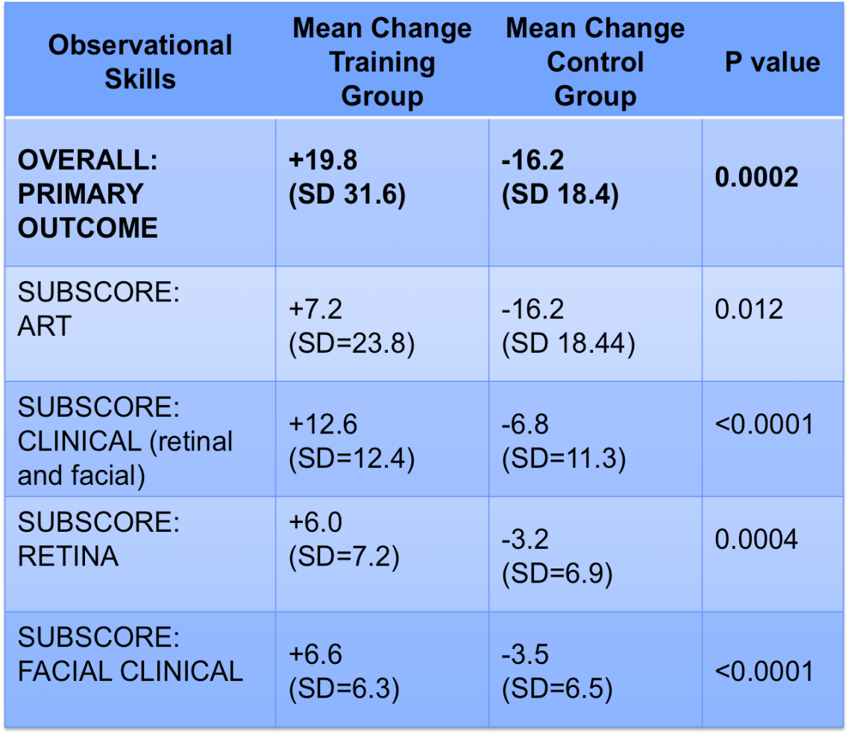
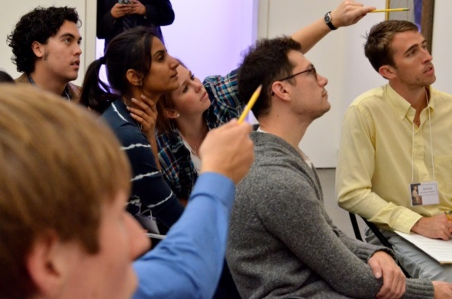
Results
Observational skills improved significantly in the Training Group (+19.8) versus the Control Group (-16.2), p=0.0002
No significant differences between groups in changes in scores on an emotional recognition test
Notes:
Major improvements:
Observations organized and structured
Evidence of flexible thinking, more than one possible interpretation
Not leaping to conclusions, focused on what is visibly evident

Slide 31
Future Directions
Identify appropriate measures of empathy
“I believe I’ve become more open-minded as a result of this course.” –representative quote from student survey
Extend to more students at more levels
Cost and capacity discussions
Co-teach course in mental health

Slide 32
Additional Faculty
Gil Binenbaum MD MSCE
Jaclyn Gurwin, MD
Karen Revere, MD
Stephanie Davidson, MD
Erin Kiskis, MD
Rebecca Mitchell
Adam Rizzo
Jenni Drozdek

